Slide 1
PRAS Walkabout Guide
How to lead excitingWalkabouts and Field Trips

Slide 2
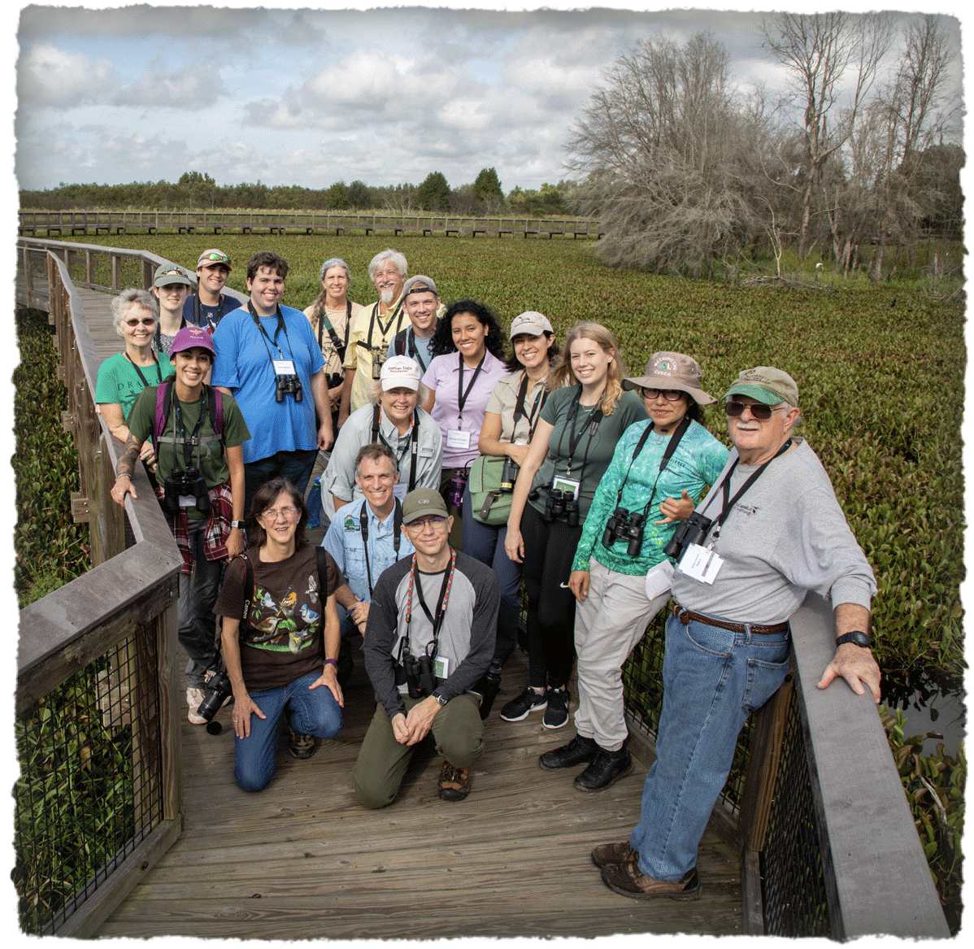
Publicity & Advertisement
Marketing: Use appealing highlights of past experiences at site or current reports of locals or ebird observations
Flyers:
Logistics: time, place, location, travel directions, carpooling, duration of trip, (fees, if any)
Contact information: phone, email, website calendar, social or printed media, where to look for updates or changes
Site description: easy/moderate/difficulty hiking, current conditions (wet, sandy, etc.).
What to bring/wear: sunscreen, hat, shoes, snack, water
Tip: if you use onsite guides, state their name & title, provide a little background on them, their expertise or speciality & if they are the site manager. Indicate the management agency that oversees the property.
Ask how PRAS leaders can be of assistance. Don’t forget to thank them, if they guide the trip.

Slide 3
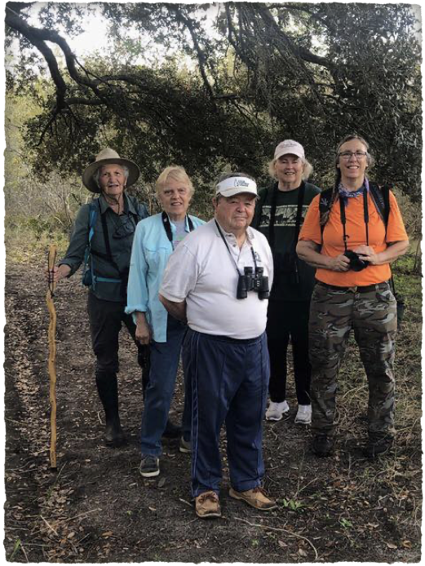
Pre Planning Tips
Scout the location prior to the walk date. Arrange for updates so you can be flexible to changes in weather forecasts & environmental conditions
Plan to arrive early & start on time.
Plan round trips – so you can return to the same spot. If someone cannot complete the walk, choose a good turning around midpoint or plan to bring an assistant to escort individuals back to the starting point.
Pick “talking stops” wisely, each should have a purpose, be brief. Be sensitive to the pace of your participants, wait for gatherings to say important facts, add spots for participants needing rest. Practice & time your talks.

Slide 4
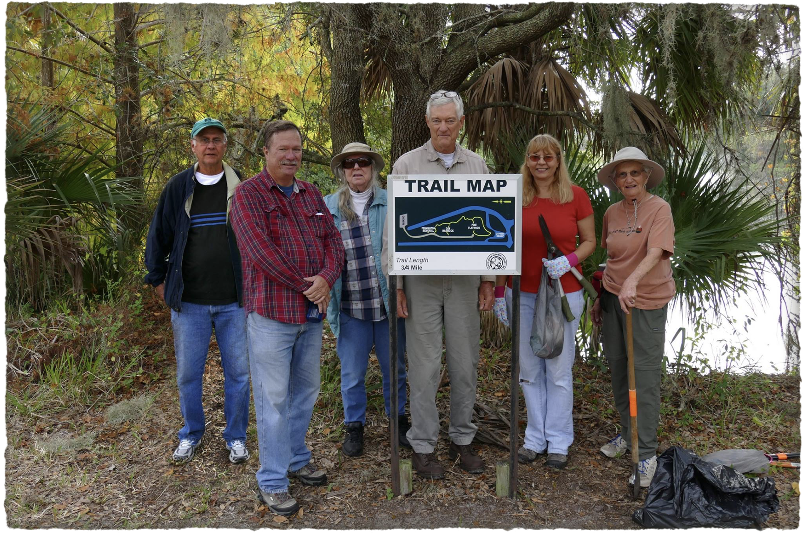
If you are the site guide,
Introduce organization & yourself with a brief background
Describe facility amenities, parking, show site map. What to carry/wear sunscreen, hat, shoes, snack, water.
3. Explain trail conditions, easy/moderate/difficulty hiking, wet, sandy, etc. possible hazards and duration of trip.
4. Know your audience beforehand or ask them upfront
a. New members - what do you want or expect to see
b. Adults, teenagers & children - use age level appeal
c. Ask for experts in the group or levels of knowledge
5. Inform your group of interesting current ebird observations and/or use the knowledge of any locals who are present
6. Describe the highlights of the site at various stops
a. Indicate the ecosystems along the trails
b. Are there any rare animals, insects or plants
c. Are there any unique niches, are local bird populations stable, at risk, any conservation threats: lack of fire/controlled burns, adjacent land uses, urban sprawl, climate change impacts.
Remember your sense of humor

Slide 5
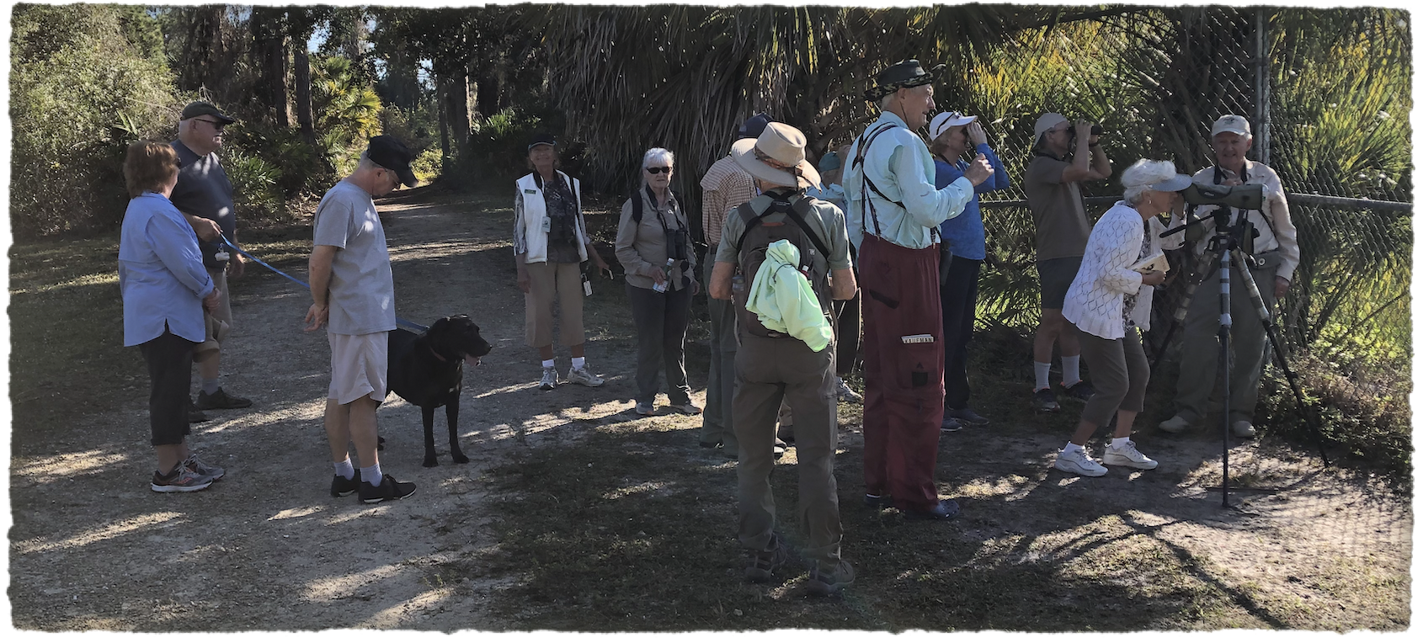
More site guide tips:
7. Allow for late comers by planning
your first quick stop near the start.
8. Ask someone to use the ebird app.
9. Take trail maps, bird and plant lists, etc.
10. Be familiar with the site, where birds are located. Laser pointers help.
11. Assign one or more people to be“sweeps” to bring up the rear. Please do not leave people behind.
12. Hand the PRAS brochure at the end and thank them for coming.

Slide 6
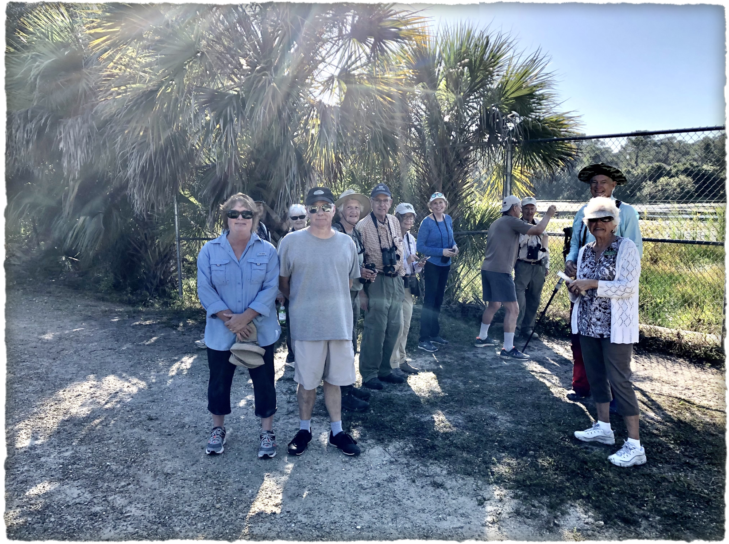
How to your Audience Learns
Visual learners – learn by seeing, use visual displays. Learn body language.
Auditory learners – learn by listening and respond well to verbal and interactive discussions. They may not look at you directly but turn an ear to you.
3. Tactile/kinesthetic learners – learn by moving, doing, and touching, think like a child.

Slide 7
Be wise not Pedantic
It is a process of communicating information in a way that engages your audience through more than just passive listening. Liken up, tell a joke or pun.
Stimulate and nurture participation. Show your passion and sense of humor.
Hands on activities are particularly effective for engaging children.
Do not try to satisfy your vanity by
teaching a great many things.
It is enough to light a spark.

Slide 8
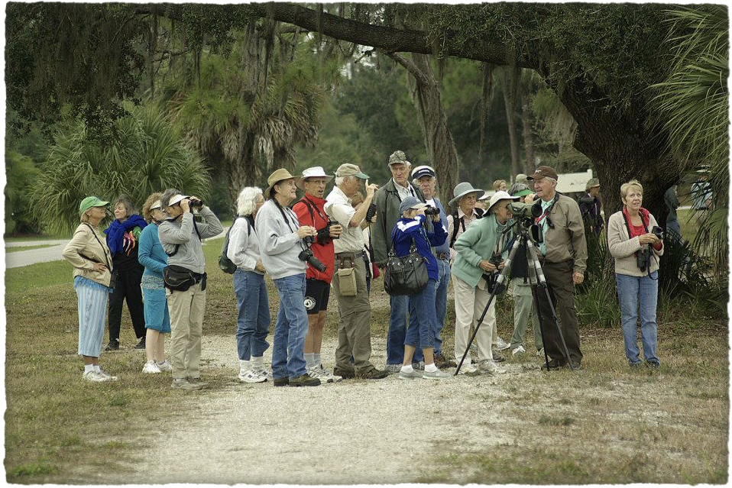
Interpretation
Provoke interest/curiosity
2. Relate to the lives of the audience. Ask why the visitor is here or what do they want to know.
Address the big picture – a theme for your field trip, consider the larger ecological system including threatened or endangered species.
Be prepared, organized, responsive, & confident.
Be professional, patient and kind.
Allow for individual self-discovery and reflection.
Don’t forget your sense of humor & to enjoy.
It’s not about who knows the most.

Slide 9
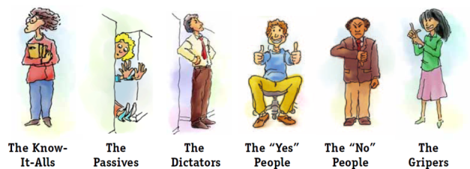
It’s OK to say I don’t know
There will sometimes be one difficult person in the group – it is your responsibility to respond in a professional discreet manner. Ask them to co-lead, partially agree or say “good point” or “I hadn’t thought of that”. If someone rushes ahead or loudly points frightening birds to the back of the bush, compliment their sighting ability & assign them a beginner to assist, etc.
Be careful of sarcasm and correcting wrong id guesses from the audience. Use phrases like “someone thought it might be a _____” instead of saying “no or you are mistaken”

Slide 10
Tips for School Trips
1. Children are self-oriented & curious(fantasy & reality are the same) - everything is alive
2. Make your expectations clear before you start, Repeat rules 3x, set specific limits on behavior (stay on the trail… do not pass the leader)
3. Use play, fantasy and the senses, keep it simple
4. Teenagers are loyal to each other. Use this
5. Give problem kids something to do (hold your papers, give out bird lists)
6. Solicit expertise from your audience, if you find an expert assign them as co-leader or sweep.
7. If you have a large group, create partners, a buddy system
Do not yell, wait for everyone to quiet down.

Slide 11
Checklist: what to bring
Binoculars, scopes, laser pointer
Insect spray, sunscreen, sunglasses, hat, water, snacks
Dress for weather & terrain conditions, protective gear, second set of clothes/shoes
Iphone with apps, guide books, site maps, bird & other species lists
First aid kit, baking soda for fire ants, extra water
PRAS waiver, incident report form, emergency contact info
PRAS Brochure at the end & thank them for coming

Slide 12
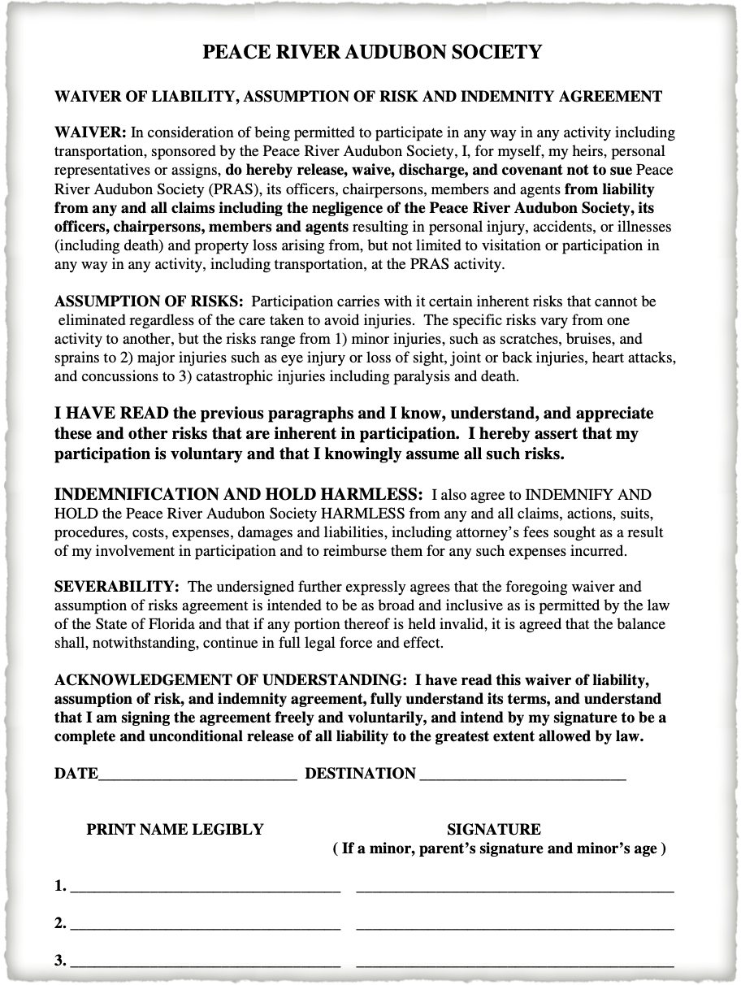
Waiver Form
Before you go down the trail, participants should read &sign this form
It can be passed around while you explain amenities and rules

Slide 13
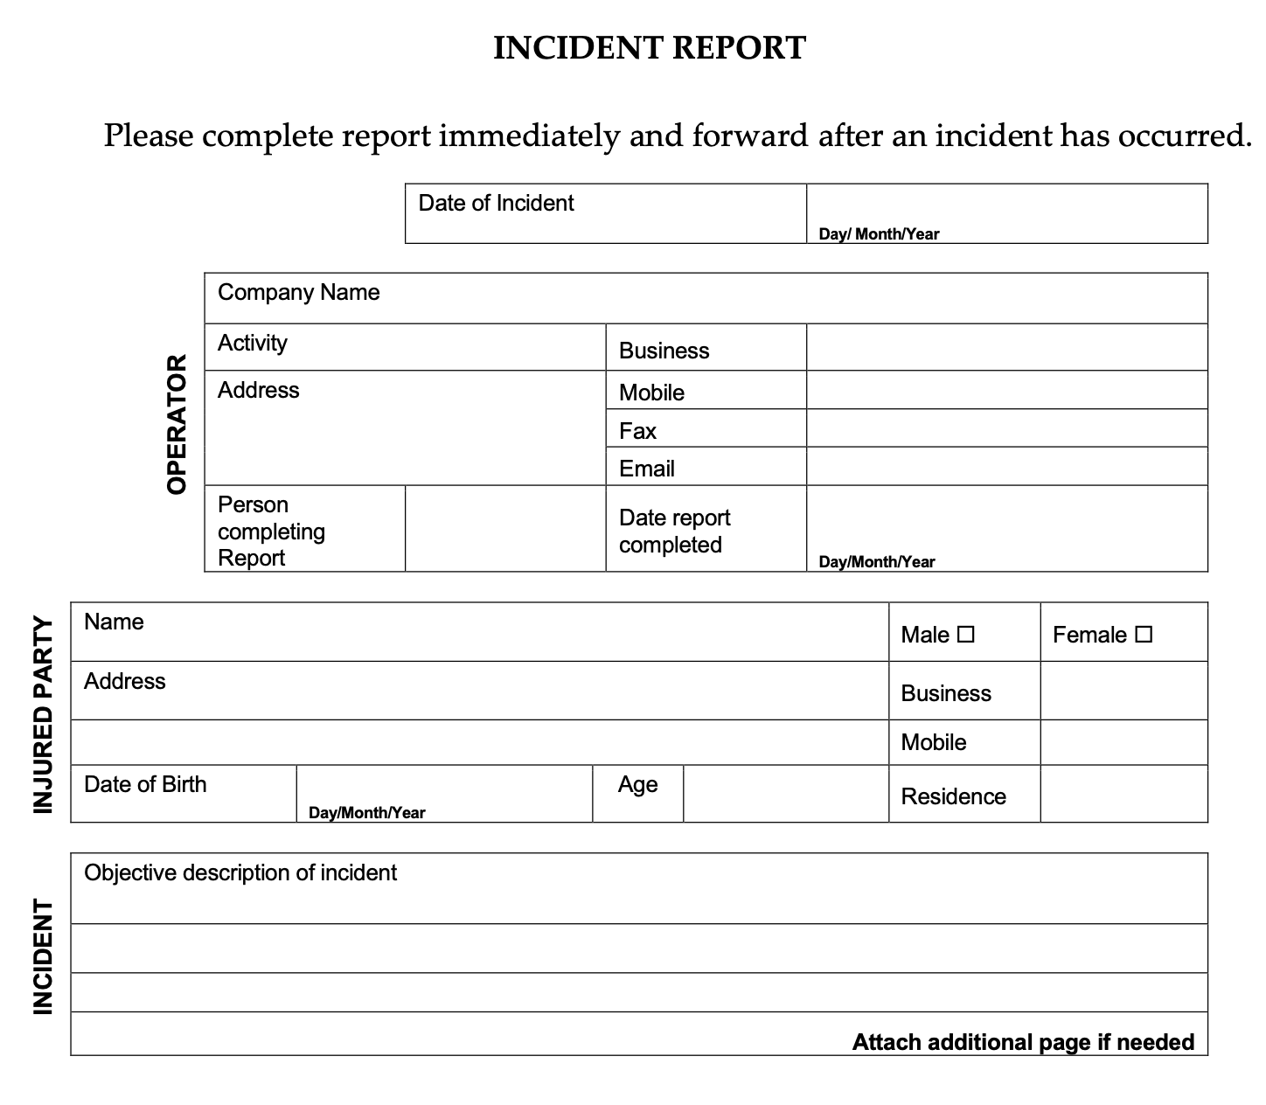
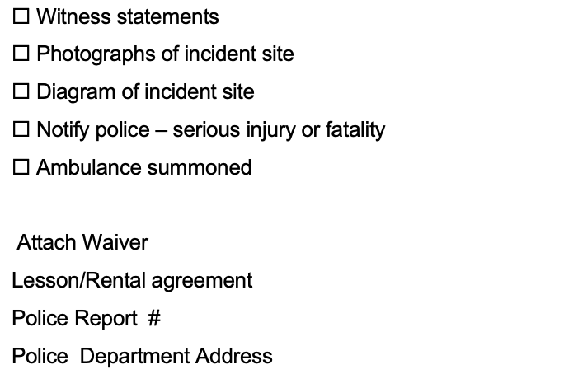
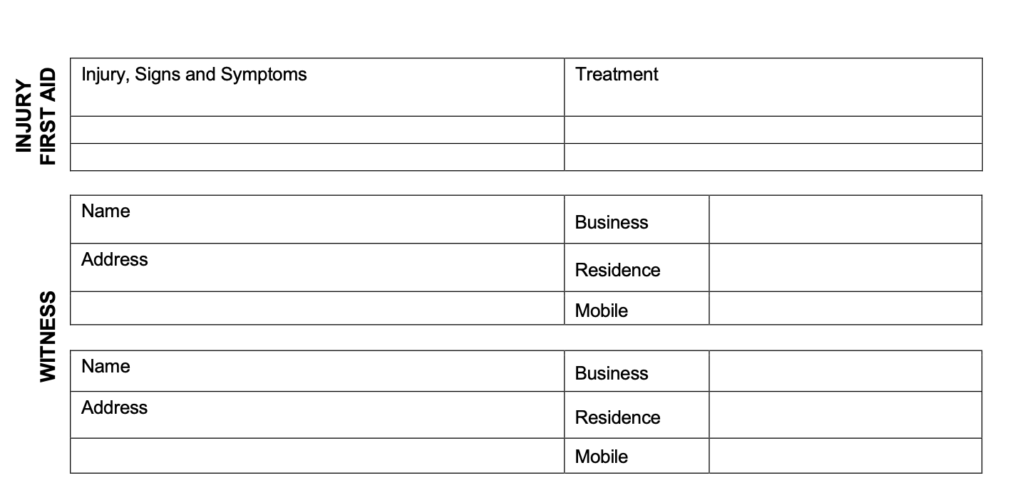
Incident Protocol
Solicit if medically trained hiker is
present to administer first aid, CPR
or facilitate necessary treatment.
Determine if an ambulance is needed,
ask someone to call or go for help.
Assess needs of injured, minimize
further injury resisting unnecessary more
harmful movement, create a circle of safety for crowd control,
attempt first aid or CPR and direct others.
Complete an incident form while memory is fresh and contact insurance company.

